Slide 1
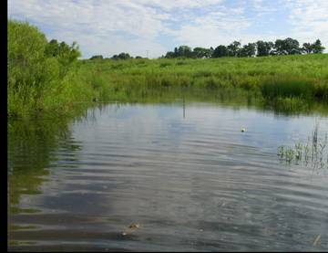
Temporal stability in aquatic food webs: the role of environmental variability and species richness
Amy Downing¹, Bryan Brown^{2,} Mathew Leibold³
1 Ohio Wesleyan University, 2 Virginia Tech, 3 University of Texas-Austin
National Science Foundation, Ohio Wesleyan Summer Science Program
Michigan State University and the Kellogg Biological Field Station

Slide 2
Environmental variability
Species richness
Stability of communities
(temporal stability or CV)
Aggregate zooplankton
community
Biomass or density
Individual zooplankton
populations
time

Slide 3
Community stability mechanisms
Compensation/asynchrony
Statistical averaging
Overyielding
Selection effect
Facilitation
Weak interactions,
trophic complexity
Community
biomass
Population
time

Slide 4
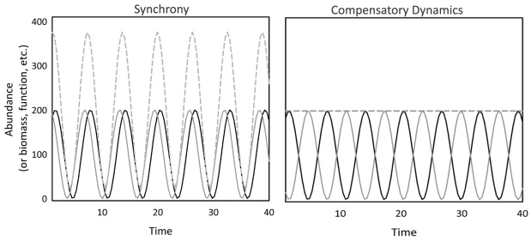

Slide 5
Compensatory dynamics should occur when:
Competition occurs between species
Species respond differentially to perturbations

Slide 6
Community stability mechanisms
Compensation/asynchrony
Statistical averaging
Overyielding
Selection effect
Facilitation
Weak interactions,
trophic complexity
Community
biomass
Population
time

Slide 7
Community stability mechanisms
CV = std dev / mean
Asynchrony/compensation
Statistical averaging
Overyielding
Selection effect
Facilitation
Weak interactions
Community
biomass
Population
time

Slide 8
Community stability mechanisms
CV = st dev / mean
Asynchrony/compensation
Statistical averaging
Overyielding
Selection effect
Facilitation
Weak interactions,
trophic complexity
Community
biomass
Population
time

Slide 9
Community stability mechanisms
CV = std dev / mean
Asynchrony/compensation
Statistical averaging
Overyielding
Selection effect
Facilitation
Weak interactions
biomass
Community
Population
time

Slide 10
Mechanisms
Compensation/asynch
Statistical averaging
Overyielding
Selection effect
Facilitation
Weak interactions
Effect on populations
destabilizing
destabilizing if z < 2,
stabilizing if z > 2
destabilizing over most
values of z
stabilizing
stabilizing
stabilizing

Slide 11
Mechanisms Effect on
populations
Asynch/compensation destabilizing
Statistical averaging destabilizing z < 2,
stabilizing if z > 2
Overyielding destabilizing over most
values of z
Selection effect stabilizing
Facilitation stabilizing
Weak interactions stabilizing
Effect of environmental variability
asynchrony increases
neutral
neutral
neutral
facilitation increases
neutral

Slide 12
Mechanisms Effect on
populations
Asynch/compensation* destabilizing
Statistical averaging destabilizing z < 2,
stabilizing if z > 2
Overyielding destabilizing over most
values of z
Selection effect stabilizing
Facilitation stabilizing
Weak interactions stabilizing
Effect of variable
environments
asynchrony increases
neutral
neutral
neutral
facilitation increases
neutral
* Predicted to operate even when species richness is held constant

Slide 13
Hypothesis for experiment 1:
Environmental variability stabilizes communities by facilitating compensatory dynamics between populations

Slide 14
Evidence for compensation is sparse
Plankton communities across pH gradient (Havens and Carlson 1988)
Seasonal variation in plankton communities (Vasseur and Gaedke 2007)
Inner Mongolian Grasslands (Bai et al. 2005)
Algal microcosms (Romanuk 2010, Gonzalez & Descamps-Julien 2004)
But compensation has been difficult to show experimentally and appears rare in nature (Houlahan et al. 2007) …

Slide 15
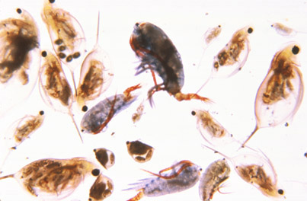
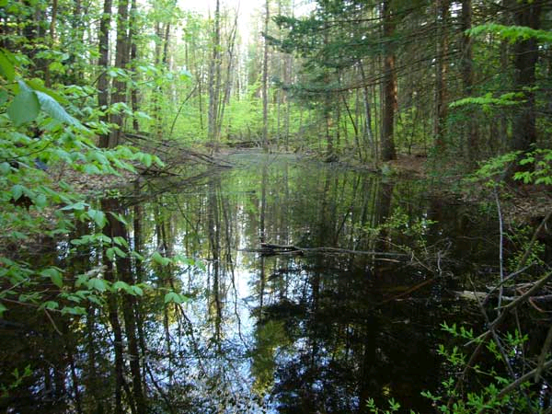
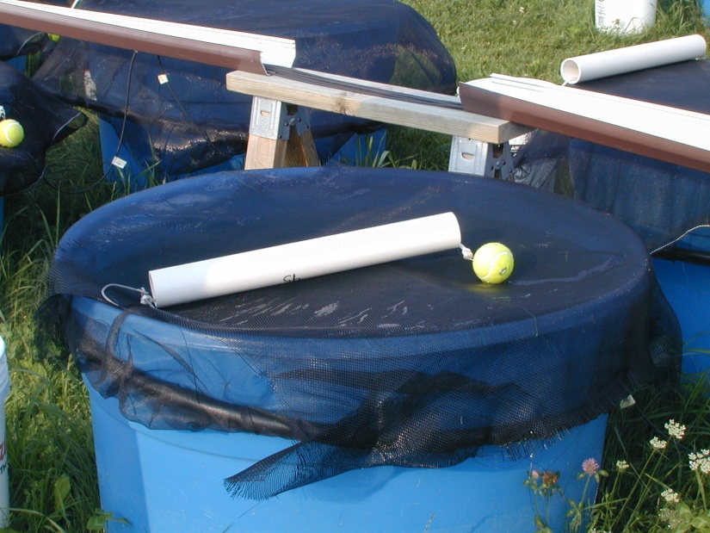
Experimental plankton ecosystems

Slide 16
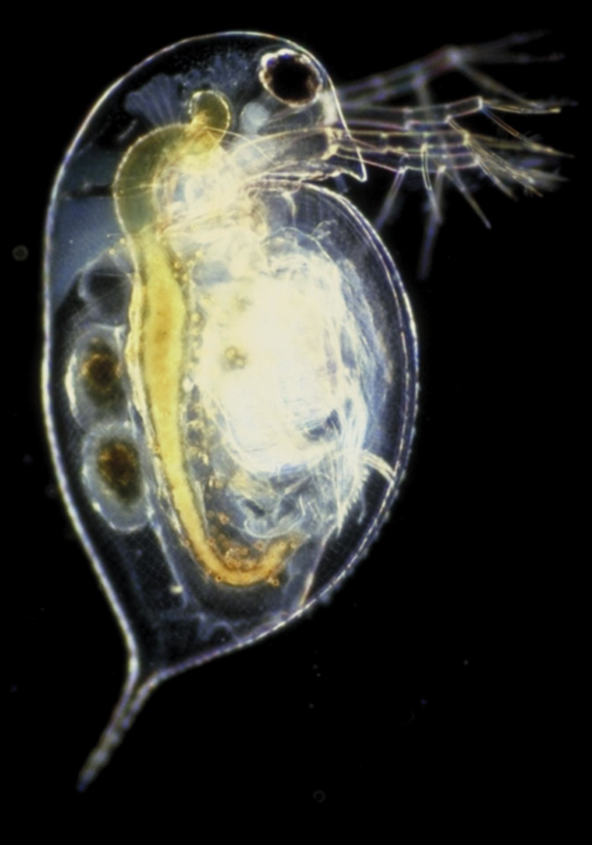
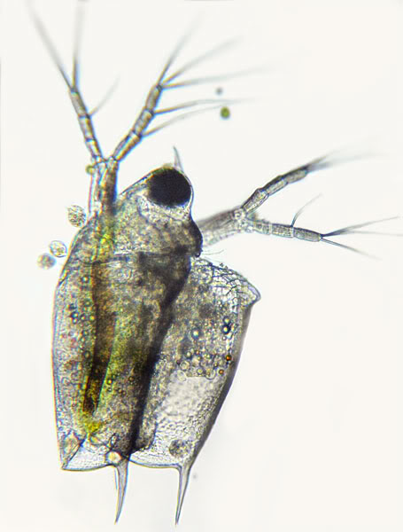
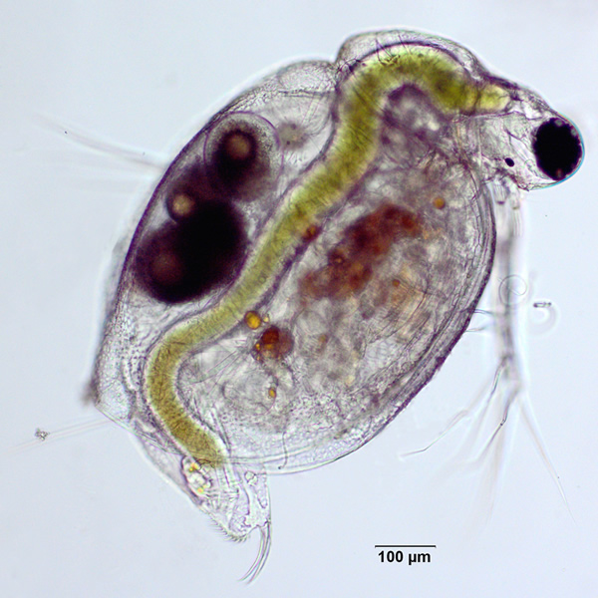
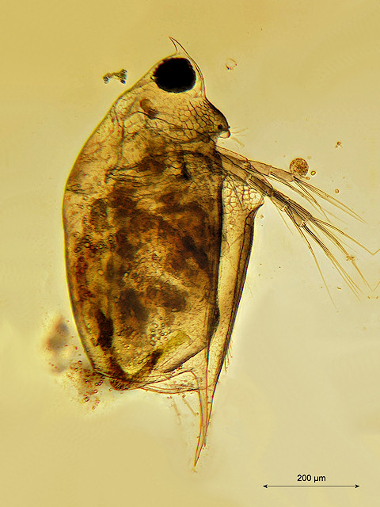
Ceriodaphnia - CER
Daphnia - DAP
Scapholebris - Sca

Slide 17
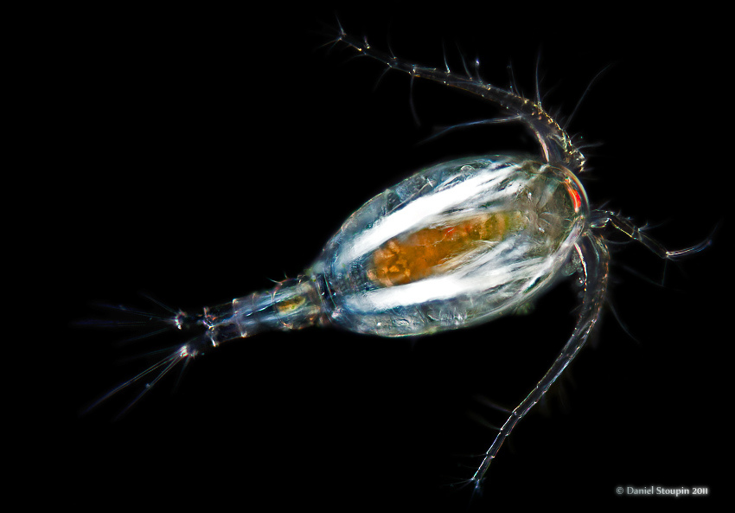
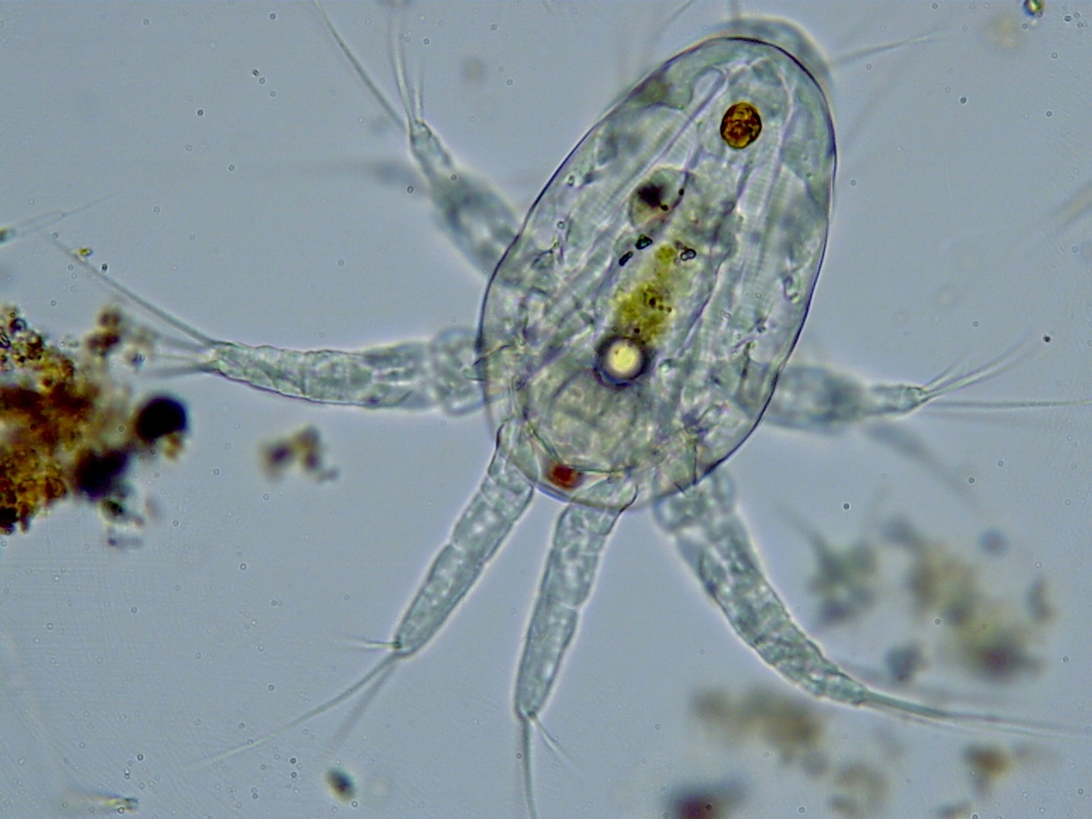
Copepod (adult) - Cop
Nauplii (nau) larval copepod

Slide 18
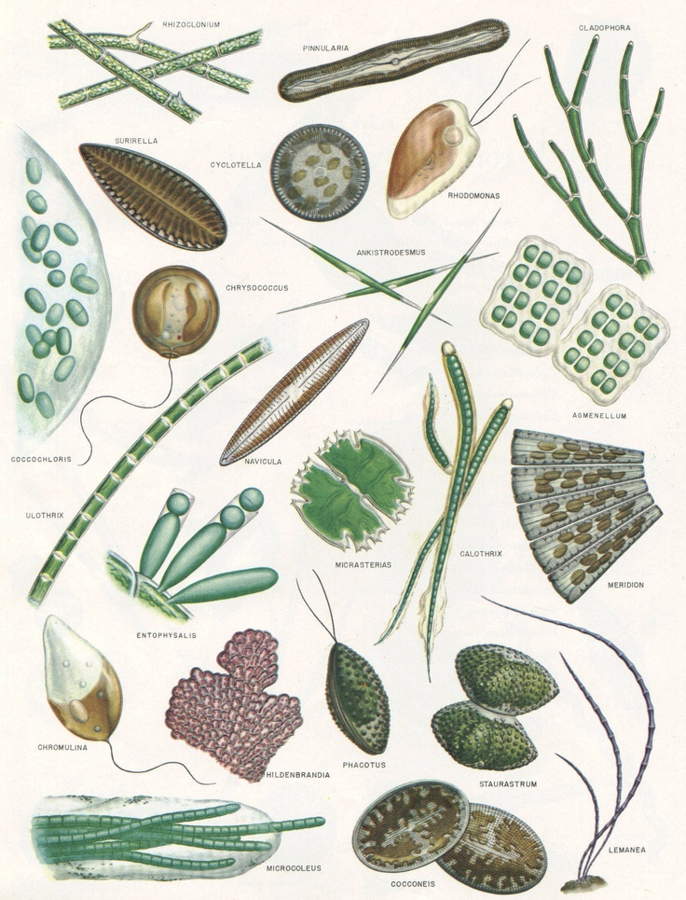
Edible (small) and inedible (large or filamentous or gelatinous) algae

Slide 19
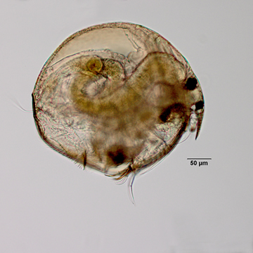
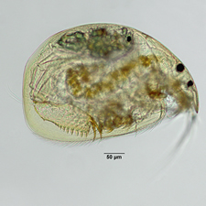
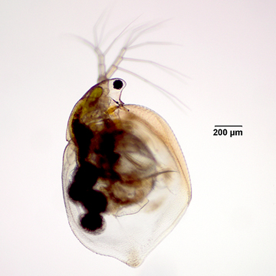
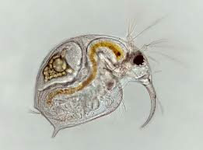

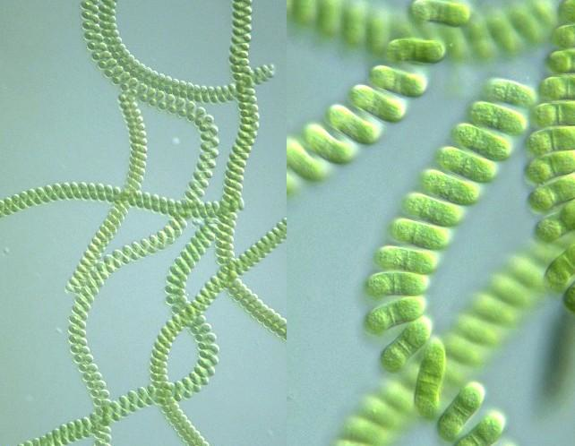
The mesocosm food webs
Dap
Cer
Sca
Clad
Cop
Nau
Edible algae (< 35 μm)
Inedible algae (> 35 μm)

Slide 20
A vector
Covariate vector
sca
clad
edib
inedib
Sca
Clad

Slide 21
Experiment 1: Effects of environmental variability on stability
Tanks all contained a hyperdiverse plankton community
collected from natural ponds
13 unique treatments x 4 reps/treatment = 52 mesocosms

Slide 22
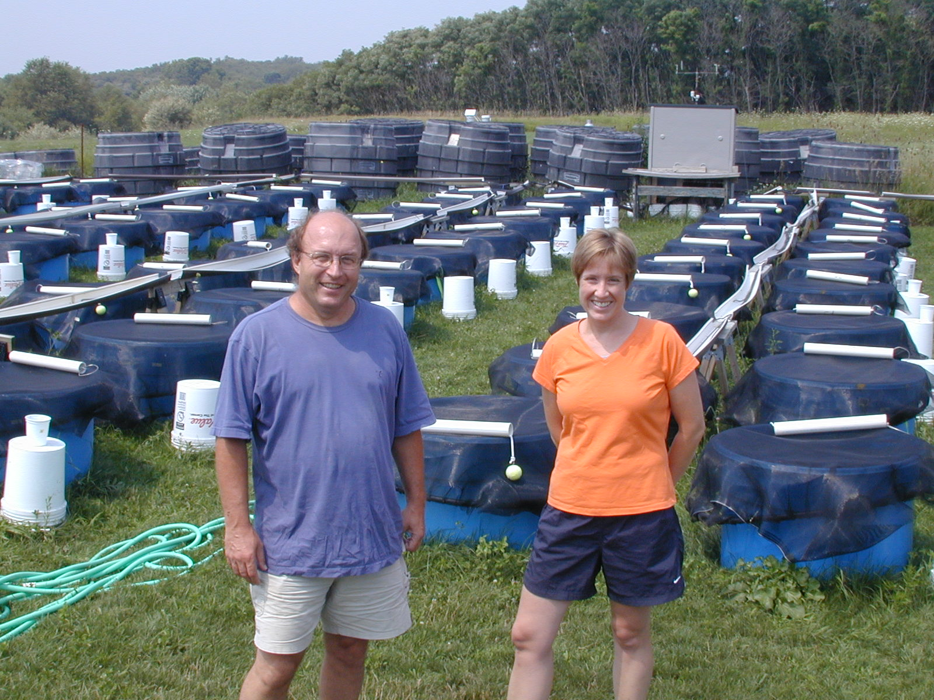
Sampling intervals every 4-5 days May–October totaling 32 sampling dates
(zooplankton, phytoplankton, productivity)

Slide 23
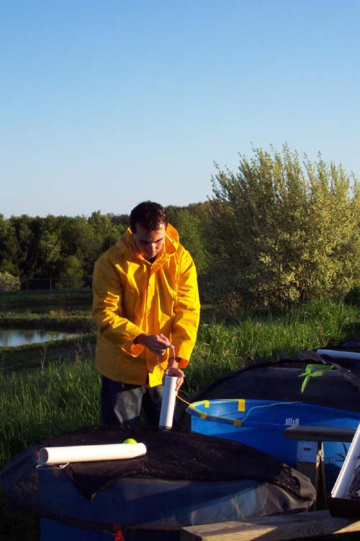
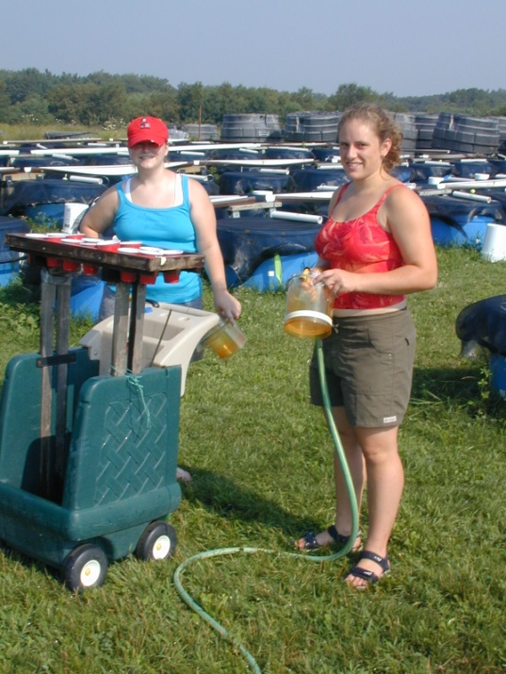

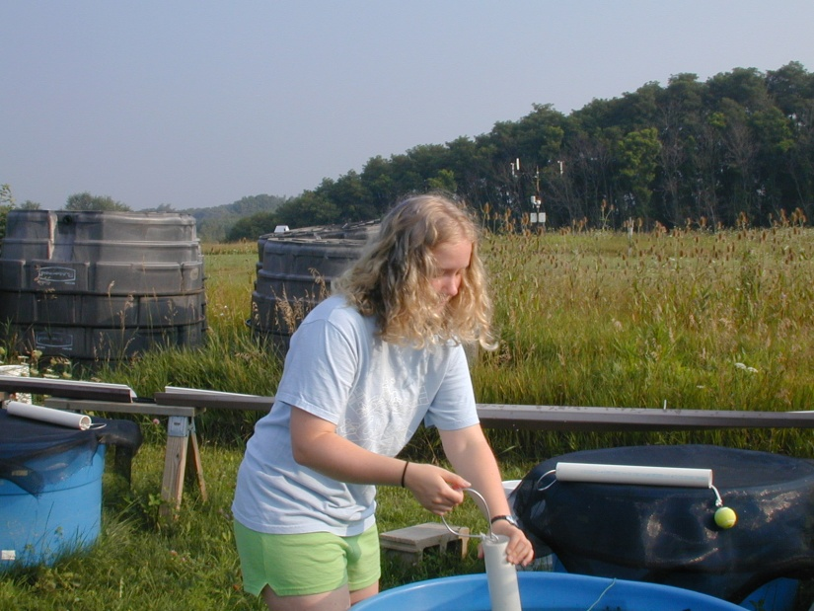
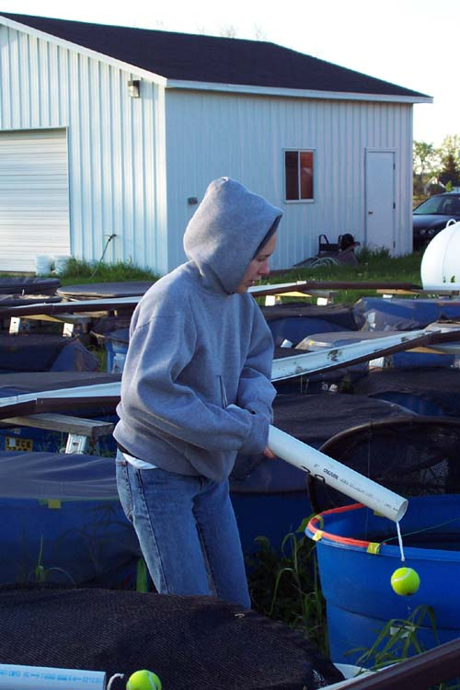

Sampling days
zooplankton, phytoplankton, net primary productivity

Slide 24
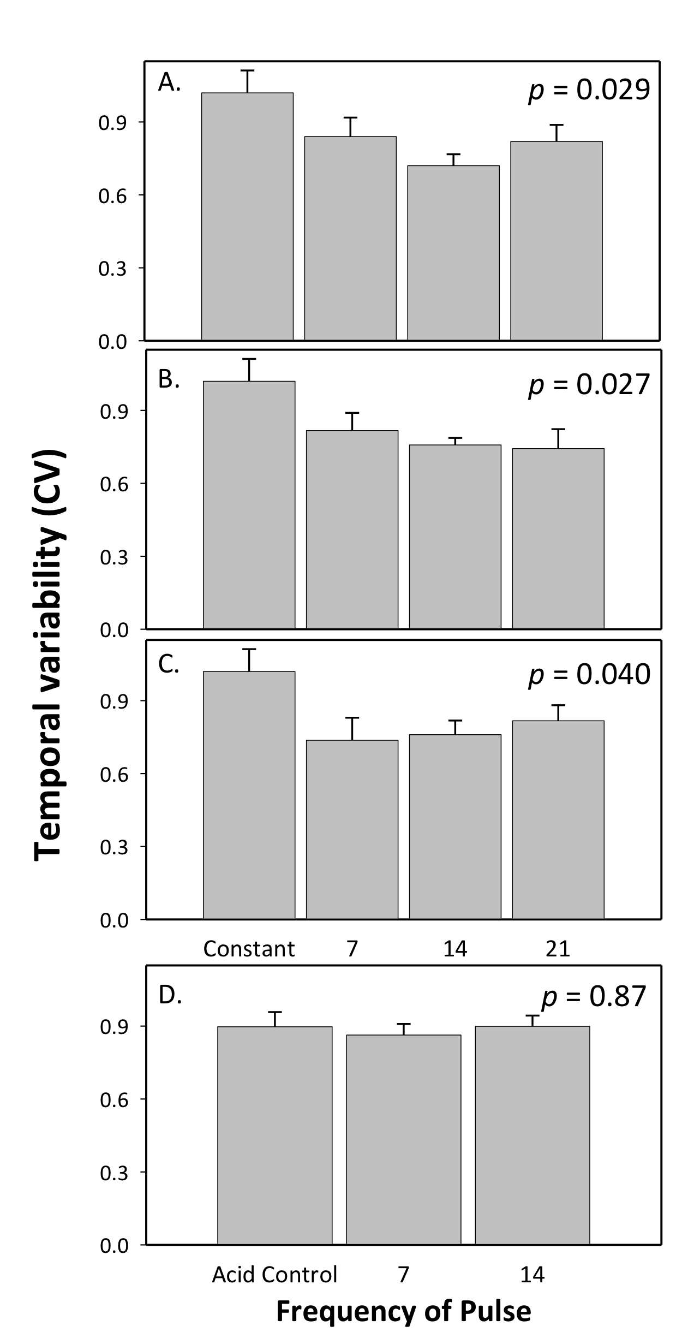
Temporal variability of zooplankton communities
N and P together
N and P alternating
zooplankton biomass
Light and shade pulses
pH pulses
(days)

Slide 25
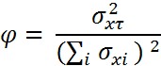
Asynchrony (compensation)
observed community variance
=
max community variance if species perfectly synchronous
φ= 1, synchronous
φ= 0, asynchronous
Loreau M. & de Mazancourt C. (2008) American Naturalist, 172, E48-E66

Slide 26
Observed species oscillations are messy
500
400
300
Zooplankton abundance
200
100
0
0
40
80
120
Days

Slide 27
Theoretical species oscillations
700
.
600
500
400
Zooplankton abundance
300
200
100
0
0
40
80
120
Days

Slide 28
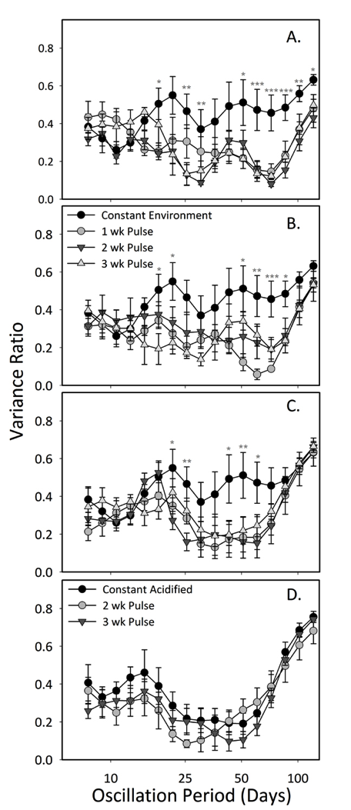
Community asynchrony
calculated at different time scales on wavelet-transformed biomass data
synchronous
N and P together
compensatory
N and P alternating
Community asynchrony
Light and shade pulses
pH pulses

Slide 29
Conclusions from Experiment 1
Environmental variability stabilizes community-level dynamics.
Compensation occurs in response to environmental variability.
Compensation occurs primarily at longer time scales (60 days).

Slide 30
Environmental variability
Species richness
Stability of communities
(temporal stability or CV)
Aggregate zooplankton
community
Biomass or density
Individual zooplankton
populations
time

Slide 31
Hypothesis for experiment 2:
Species richness stabilizes communities through multiple mechanisms, and has inconsistent effects on population stability.

Slide 32
Mechanisms Effect on
population stability
Asynch/compensation destabilizing
Statistical averaging destabilizing z < 2,
stabilizing if z > 2
Overyielding destabilizing over most
values of z
Selection effect stabilizing
Facilitation stabilizing
Weak interactions stabilizing
Effect of variable
environments
asynchrony increases
neutral
neutral
neutral
facilitation increases
neutral

Slide 33
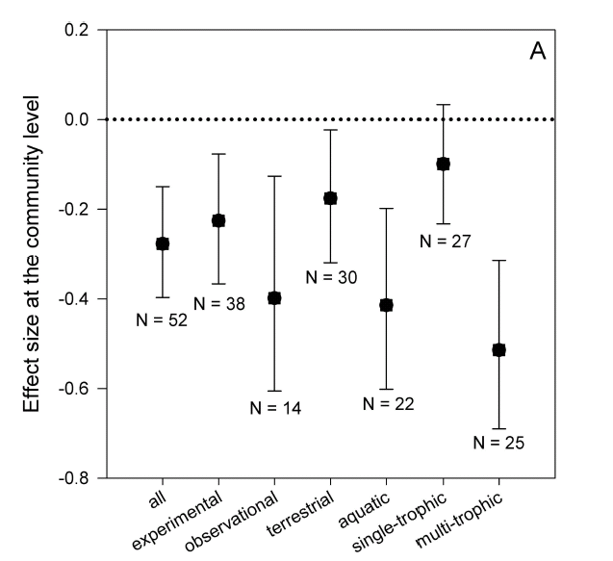
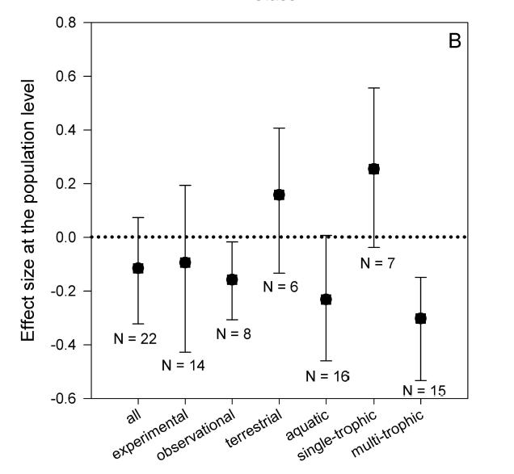
Diversity effects on temporal stability of populations & communities
Diversity stabilizes
Diversity stabilizes
Diversity tends to enhance
community stability
Diversity has inconsistent effect on
population stability
Jiang L. & Pu Z.C. 2009. American Naturalist, 174, 651-659

Slide 34
Experimental plankton ecosystems

Slide 35
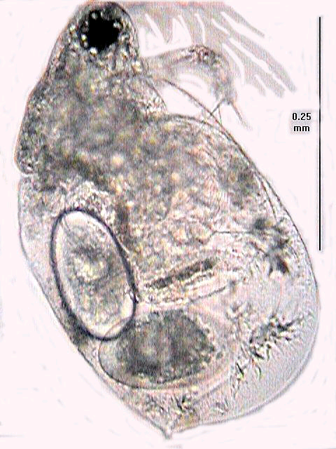
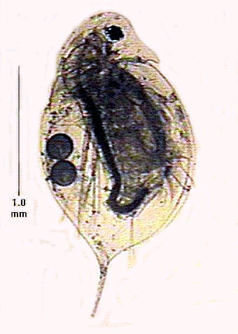
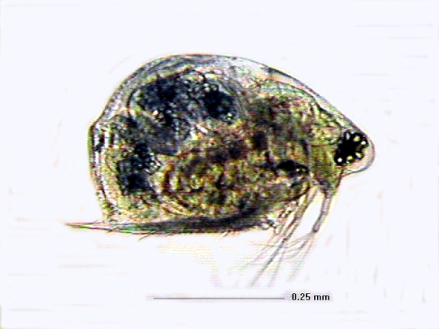
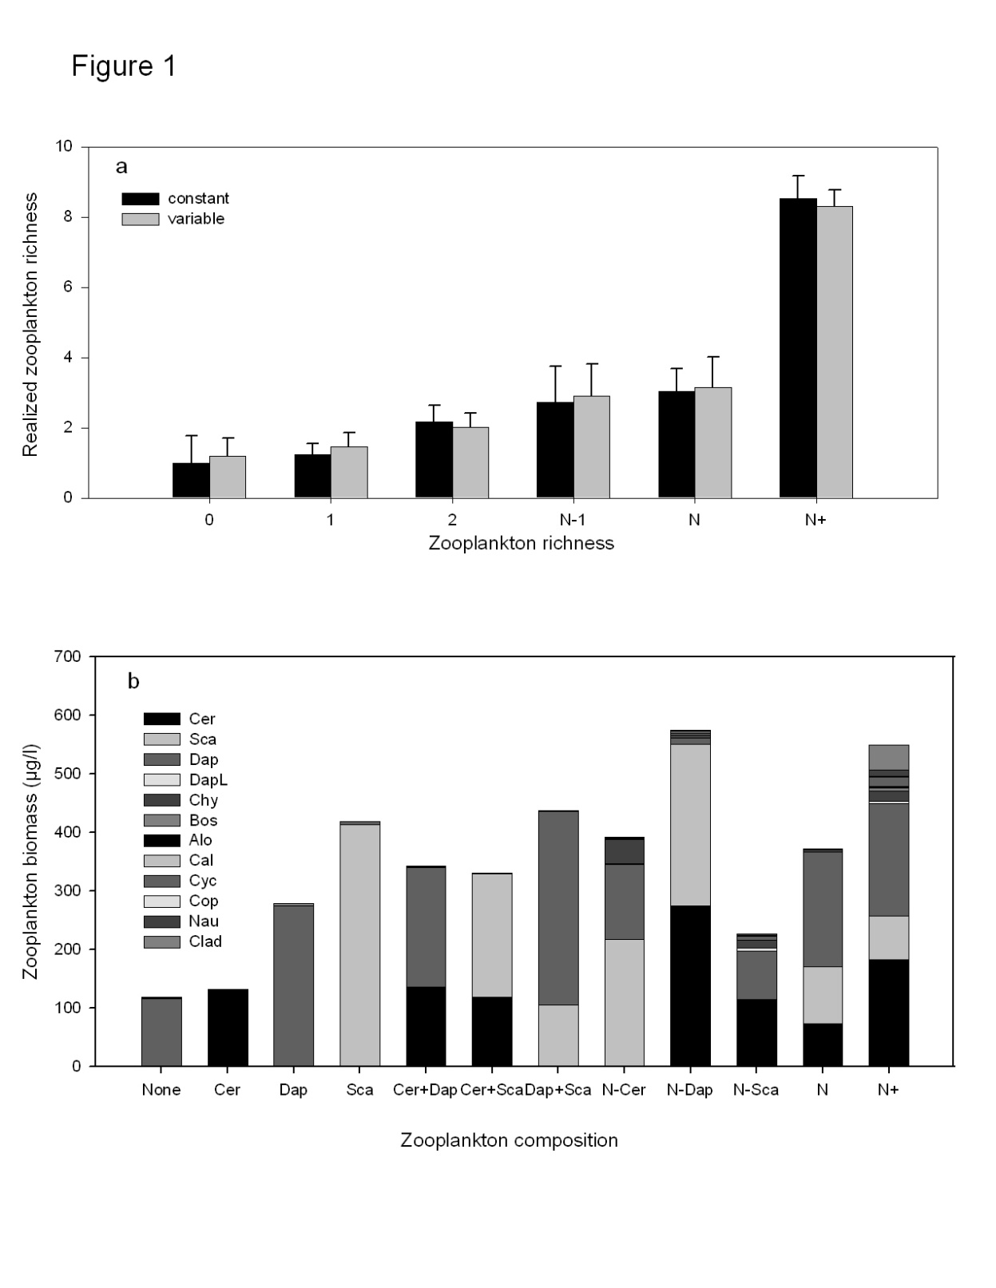
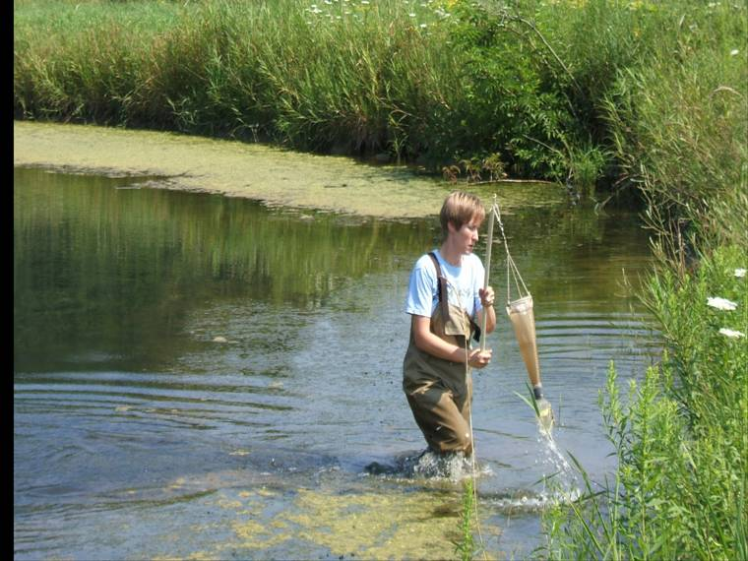
Zooplankton richness treatments
0 no zooplankton
1 1 species zooplankton monocultures
2 2 species combinations of focal species
N-1 diverse zooplankton minus a focal species
N diverse zooplankton
N + diverse zooplankton + immigration
Scapholebris
Ceriodaphnia
Daphnia
(http://www.cnas.missouristate.edu/zooplankton/default.htm).

Slide 36
Zooplankton richness X environmental variability Constant vs fluctuating nutrients (pulsed every 2 weeks)
Sampling intervals every 4-5 days May–October totaling 35 sampling dates

Slide 37
Realized zooplankton richness
Zooplankton biomass (μg/l)
1
2
N-1
Zooplankton richness and composition

Slide 38
Richness stabilizes populations & communities
ANOVA, richness effect,
F _{4,71} = 4.596 p=0.002
ANOVA richness effect,
F _{4,71} = 2.900, p = 0.028
Constant environments
Variable environments

Slide 39
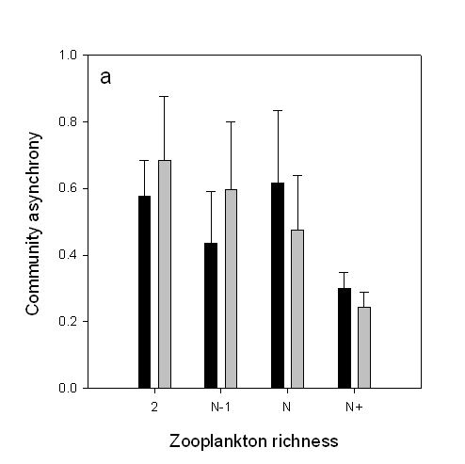
Asynchrony (compensation)
Time scale = 61 day oscillations
synchronous
Richness, p < 0.05
asynchronous
Constant environments
Variable environments

Slide 40
Statistical averaging – slope (z) of
log popn biomass vs log popn variance > 1
F _{1, 1294} = 23,302, p < 0.001, R² = 0.947).
z = 1.949 ± 0.013 (SE)
8 species have z < 2
(destabilized)
8 species have z > 2
(stabilized)

Slide 41
Overyielding - community biomass increases faster than standard deviation
ANOVA, richness effect
F _{4,71} = 2.759, p = 0.034
Linear regression, F _{1,79} = 89.89, p < 0.001,
R² = 0.532, slope = 0.95±0.100 SE
Ceriodaphnia
Scapholebris
Daphnia
Zooplankton richness

Slide 42
Selection effect –stable
species dominates at high richness
ANOVA on CV’s in monoculture, F _{2,42} = 0.626, p = 0.540
Ceriodaphnia
Scapholeberis
Daphnia

Slide 43
Facilitation & Weak interactions
- many populations stabilize
ANOVA, richness effect,
F _{4,71} = 4.596 p=0.002
linear regression F _{1,79} = 21.014,
p < 0.001, R² = 0.210
All 14 species found in more than one richness level
show lowest variability at high richness

Slide 44
Mechanisms Predicted effect
on populations
Asynchrony destabilizing
Statistical averaging destabilizing if 1 > z < 2,
stabilizing if z > 2
Overyielding destabilizing
Selection effect stabilizing
Facilitation stabilizing
Weak interactions stabilizing
Supported?
YES
YES
NO
NO
NO?
YES

Slide 45
Conclusions from Experiment 2
Species richness stabilizes both populations & communities
Asynchrony, statistical averaging, & weak interactions simultaneously enhance stability
Weak interactions may stabilize populations in food webs
Metacommunity dynamics enhance stability by increasing rare species, facilitating stabilizing mechanisms

Slide 46
Diversity effects on temporal stability of populations & communities
Diversity stabilizes
Diversity stabilizes
Diversity tends to enhance
community stability
Diversity has inconsistent effect on
population stability
Jiang L. & Pu Z.C. 2009. American Naturalist, 174, 651-659

Slide 47
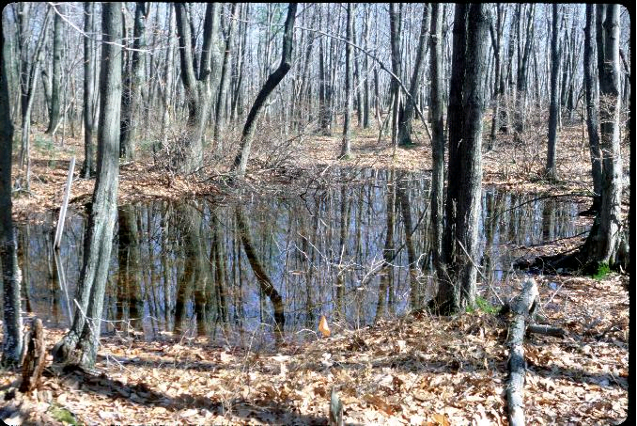

Slide 48
Q: How do ‘weak interactions’ in our MAR matrices relate to population level CV?
Determine matrix metrics that estimate interaction strength
Correlate ‘interaction strength’ to popn CVs (individual or collective?)
This question has nothing to do with comparing theoretical measures of stability based on the matrix to empirical measures.
This question uses data to estimate interaction strength which can then be used to determine if interactions strengths are correlated with temporal variability.

